Slide 1
Nanocrystalline Silver Layer of Knitted Polyester Outperforms Other Silver-Containing Wound
Dressings in an In Vitro Wound Model
Jonathan Hus
Notes:
Hi, my name is jonathan Hus and before I start I would like to say thank you to the organizers for allowing me to present my research at this conference
I will be presenting my work on a Nanocrystalline Silver Layer of Knitted Polyester that Outperforms Other Silver-Containing Wound Dressings in an In Vitro Wound Model

Slide 2
Disclosure
Speaker Name: Jonathan Hus
I do not have any relevant financial relationship(s) with any commercial interest that pertains to the content of my presentation.
Notes:
I have nothing to disclose

Slide 3
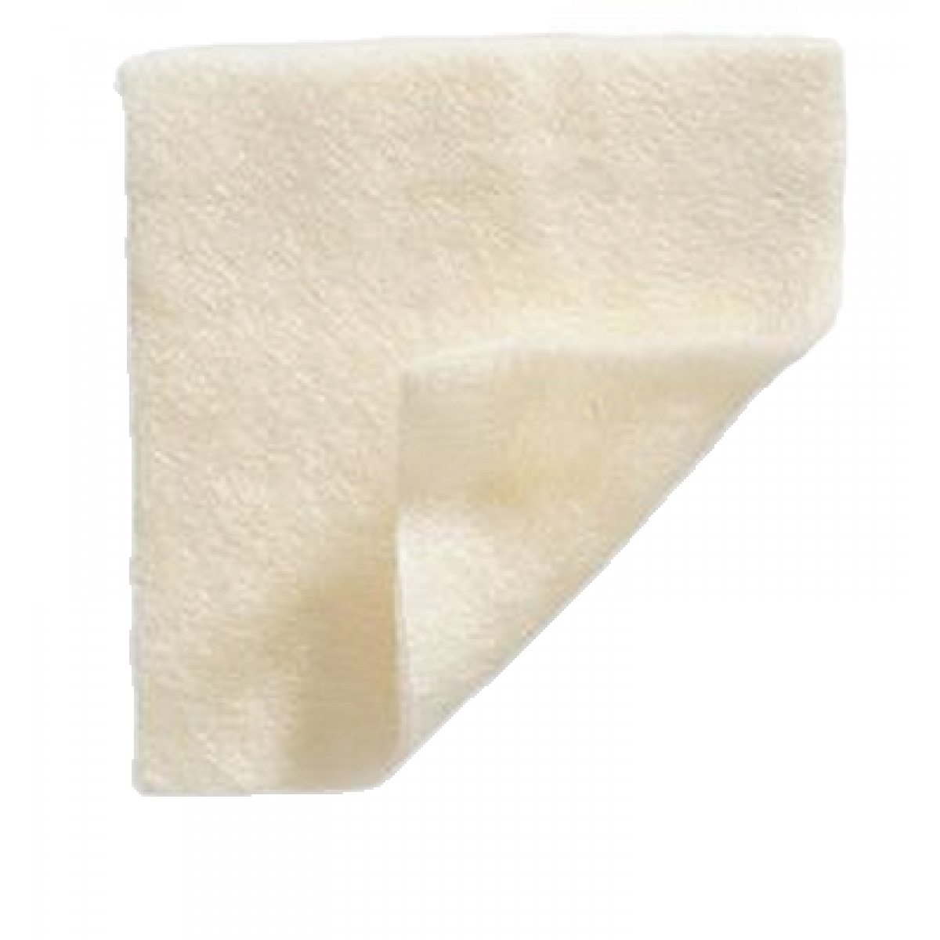
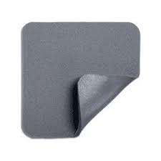
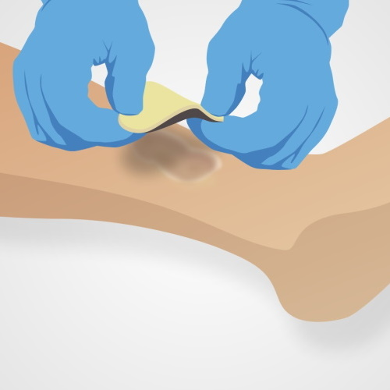
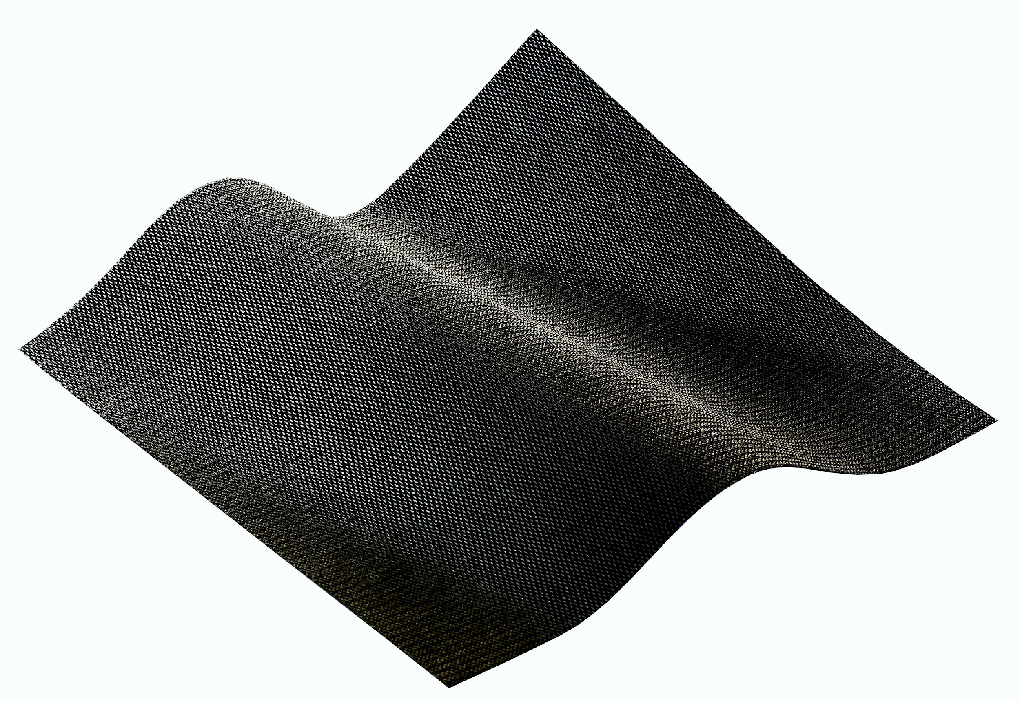
Silver-Containing Wound Dressings (SCWDs)
Ag⁺
Ag⁺
Ag⁺
add silver ion
Ag⁺
Ag⁺
https://www.blowoutmedical.com
https://encrypted-tbn0.gstatic.com
Ag⁺
Ag⁺
Ag⁺
Ag⁺
https://www.bbraun.com
Ag⁺
https://encrypted-tbn0.gstatic.com
Wound dressings
Notes:
Silver has been used for its cytotoxic effects on fungi, bacteria, and viral microbes for thousands of years. For example, it dates back to Egypt in 1850 BCE where it was directly applied to wounds, similarly as it is used today.
Silver-Containing Wound Dressings(SCWDs) use their properties to inhibit and or repress the bacteria when the silver is in its soluble form of Ag+ or Ag0. Ag0 is a silver nanocrystal which is a cluster of silver ions. These Ag0 clusters are found to be used in dressings such as Acticoat.
The various dressings are created and then impregnated with silver ions which are then released after making contact with the biofilm developed on a wound. The silver disrupts this biofilm and aids in the healing process of the wound.

Slide 4
Composition of SCWDs
Product | Silver Composition
Acticoat Flex 3 | Silver nanocrystalline structure (Ag⁰, slow release, converts to Ag⁺)
Aquacel Ag | 1.2% Ag⁺(silver salt not specified)
Maxorb II Ag | Silver sodium hydrogen zirconium phosphate (Ag⁺)
Mepilex Ag | Ag⁺(silver salt not specified)
Mepitel Ag | 0.13 % silver chloride (Ag⁺)
Optifoam Ag | Ag⁺(silver salt not specified)
Tegaderm Alginate Ag | Silver sodium hydrogen zirconium phosphate (Ag⁺)
Notes:
Some of the dressings tested contain different makeups and materials from one another such as hydrofibers, foam pads, or different levels of silver ions.
As mentioned previously, each of the compared SCWDs have different structures and materials. Therefore, I would like to point out that Acticoat isn't composed of just Ag+ ions like the rest of the dressings. Acticoat is composed of silver nanoparticles which are clusters of silver ions.
Prior SCWDs provided a quick initial load of silver ions and would deplete relatively fast when in contact with serum chloride. Current novel SCWDs are designed to release a slow and steady supply of silver ions which would subsequently be consumed far less rapidly. Acticoat’s Ag0 silver nanoclusters provide a steady release of silver to interact with target bacteria and then become inactivated by protein and anion complexes in wound fluid

Slide 5
Purpose
To examine the efficacy of selected SCWDs in an in vitro wound model
Notes:
Our study aimed to determine and compare the efficacy of the seven selected SCWDs in an in vitro wound model. We hypothesized that since each SCWD is made up of different materials and components, then their effects on the bacteria should vary from one another

Slide 6
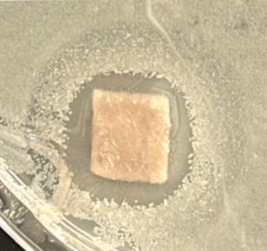
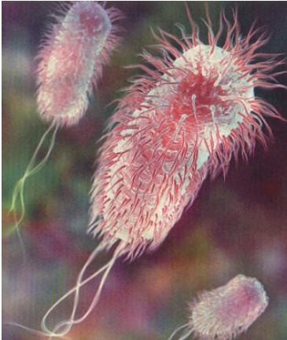
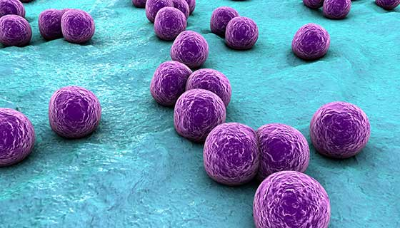
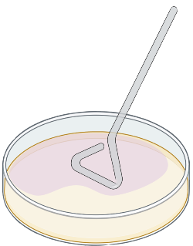
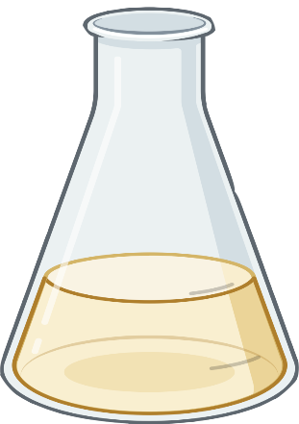
Methods
37°C
Terminology
Inhibition = no bacterial growth (zone of inhibition)
Repression = slow bacterial growth (zone of repression)
S. aureus
16-18 hours
E. coli
6 hours
37°C
LB Agar Plate
Notes:
In our study, we used a standard assay to examine the effectiveness of the various SCWDs' ability to inhibit and or repress the growth of two strains of bacteria (E. coli and S. aureus) which are both commonly found in wounds. Bacteria were grown for 6 hours and then applied to the surface of nutrient agar with the embedded SCWDs and incubated at 37°C overnight. After around 18 hours we observed the zone of inhibition and or zone of repression around each wound dressing and then compared them to one another through an ANOVA analysis.
We describe the zone of inhibition as the zone of no bacterial growth around the dressing and the zone of repression as slow bacterial growth around the dressing.

Slide 7
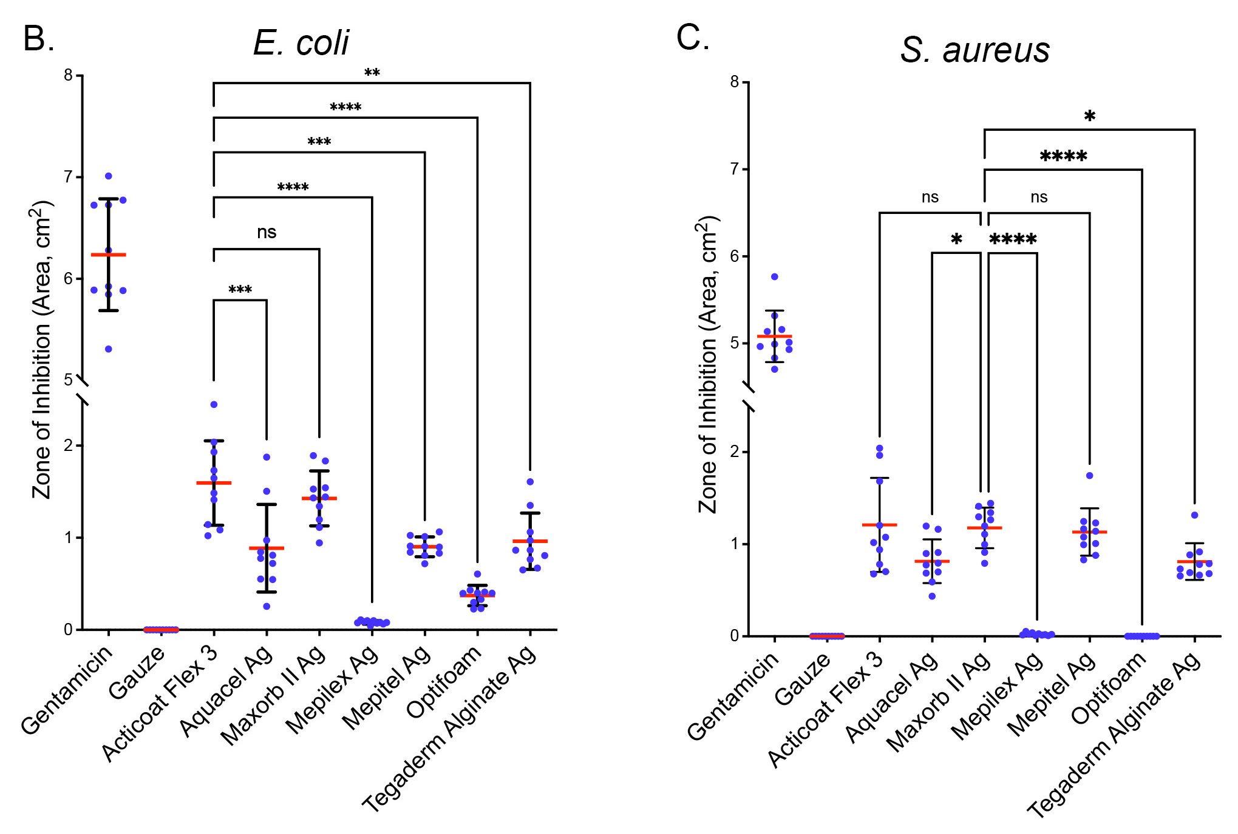
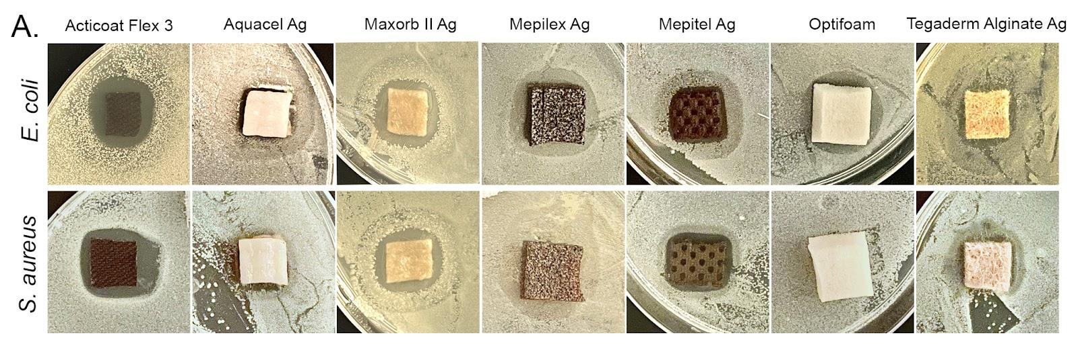
Results: Acticoat Flex 3 was most effective at inhibiting bacterial growth
Zone of Inhibition
Notes:
Focusing on panel A, I would like to remind you all that throughout this study, we classified the zone of no growth around each dressing as the zone of inhibition, which is what we will be looking at currently.
In Panel B, we are comparing each of the 7 dressings and their inhibitory effects on E. coli. I would like to mention that red line represents the average zone of inhibition from each dressing where the higher the average is, the greater the effectiveness. Therefore, as shown, Acticoat presented the greatest inhibitory effect along with Maxorb close behind it. Additionally, Mepilex expressed a low inhibitory effect on E.coli with optifoam just above it.
Similarly to before, In Panel C, we are still comparing the inhibitory properties of the SCWDs but in this case, against S. aureus. Again, Acticoat presented the greatest inhibitory effects with Maxorb as a very close second, and Mepitel and Optifoam expressed the lowest inhibitory effects.

Slide 8
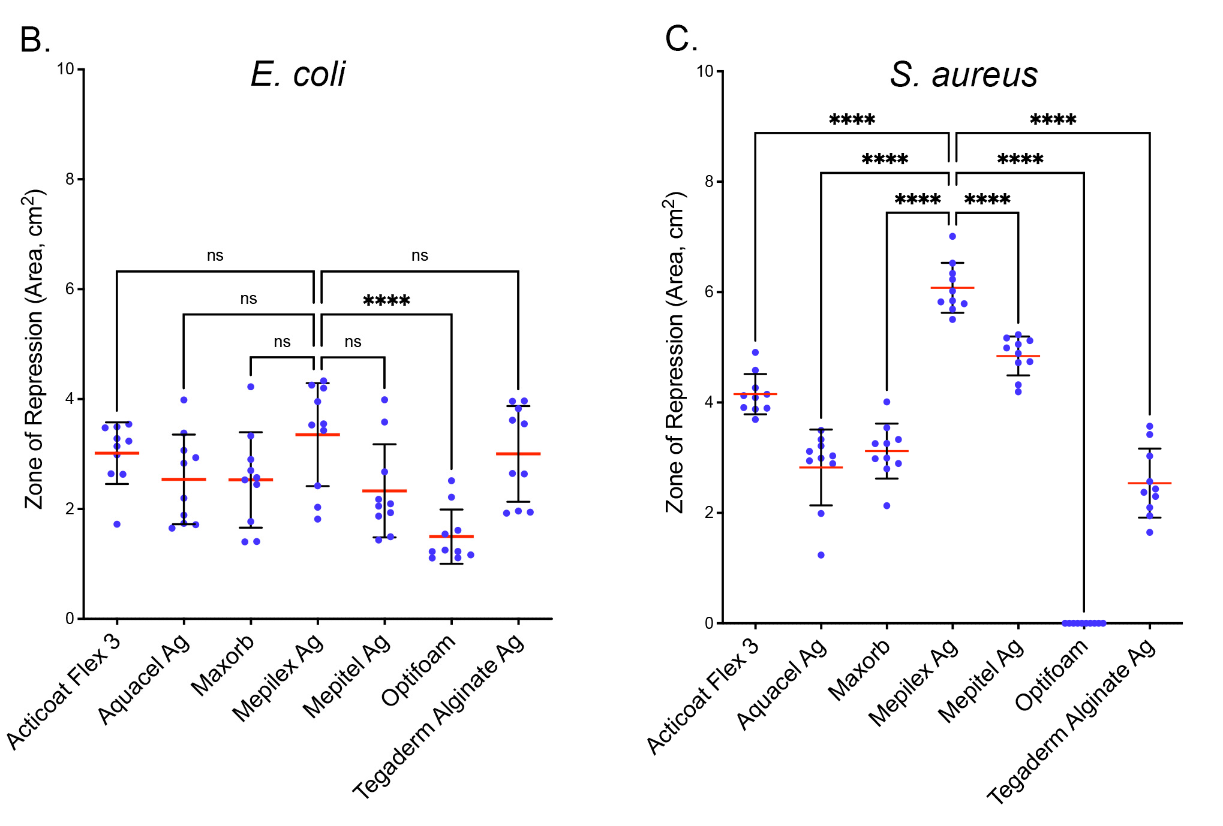
Results: Mepilex Ag was most effective at repressing bacterial growth
Zone of Repression
Notes:
While taking a close look at panel A, I would like to remind you all again that in this study, we classified the zone of small bacterial growth around each SCWD as the zone of repression, which is what we will currently be focusing on.
In panel B, we are now comparing the repressive effects of the SCWDs on E. coli. Interestingly, Mepilex Ag expressed the greatest repressive effect. Acticoat led close behind it and Optifoam performed with the lowest repressive effect.
Now looking at panel c, we can determine a similar trend in that Mepilex presented the greatest repressive effect on S. aureus with Acticoat performing close behind, and Optifoam with the least repressive effect.

Slide 9
Results: Acticoat Flex 3 outperforms the other tested SCWDs
 | Inhibition |  |  | Repression
SCWD | E. coli | S. aureus |  | E. coli | S. aureus | Score
Acticoat Flex 3 | ++++ | ++++ |  | +++ | +++ | 14
Aquacel Ag | +++ | ++ |  | ++ | + | 8
Maxorb II Ag | ++++ | +++ |  | ++ | ++ | 11
Mepilex Ag | + | + |  | +++ | ++++ | 9
Mepitel Ag | +++ | +++ |  | ++ | +++ | 11
Optifoam | + | - |  | + | - | 2
Tegaderm Alginate Ag | +++ | ++ |  | +++ | + | 9
Notes:
In order to summarize and simplify the information given in the previous graphs, we created a semi-quantitative table. Each dressing was given a score through an unbiased analysis where each + acts as 1 point.
Acticoat which performed the best across all conditions received a score of 14. I would like to mention that Maxorb II Ag and Mepitel Ag also performed moderately well across conditions.
Additionally, I would like to point out that even though Mepilex expressed a lower inhibitory effect than the other SCWDs, it did however show a strong repressive effect.
Lastly, Optifoam performed the worst across all conditions and therefore received the lowest score.

Slide 10
Conclusions
The antibacterial properties of Acticoat Flex-3 outperformed those of selected SCWDs
Maxorb II Ag and Mepitel Ag were also generally effective across conditions, but to a lesser extent than Acticoat Flex-3
While Mepilex Ag showed little to no inhibitory effects on the two strains, it did however present a strong repressive effect
Compared with the selected SCWDs Optifoam was not effective across any of the conditions tested
Notes:
The following conclusions were drawn with respect to the data gathered throughout the study.
Acticoat expressed the greatest antibacterial properties and outperformed the other selected SCWDs
Additionally, Maxorb II Ag and Mepitel Ag were generally effective across conditions however to a lesser extent than that of Acticoat.
Mepilex Ag, which showed little inhibitory effects, did however express a great repressive effect on the two strains.
Lastly, when tested across conditions, Optifoam was not effective when compared to the other selected SCWDs

Slide 11




Acknowledgements
Joel Grunhut (writing advisor)
Nir J. Hus M.D, Ph.D., FACS
Ricardo F. Frausto (research mentor)
Notes:
Finally, I would like to acknowledge Joel Grunhut and Dr. Nir Hus from the Florida Atlantic University Charles E. Schmidt College of Medicine.
I would also like to acknowledge my research Mentor Ricardo Frausto from the UCLA David Geffen School of Medicine and from Polygence.
Thank you to each of you for your guidance and support.
In addition, I am a high school student and I would like to thank my high school Donna klein Jewish academy for their support as well.
Lastly, I would like to thank you all for your attention and if you have any questions please feel free to ask

Slide 12


Q&A

Slide 13
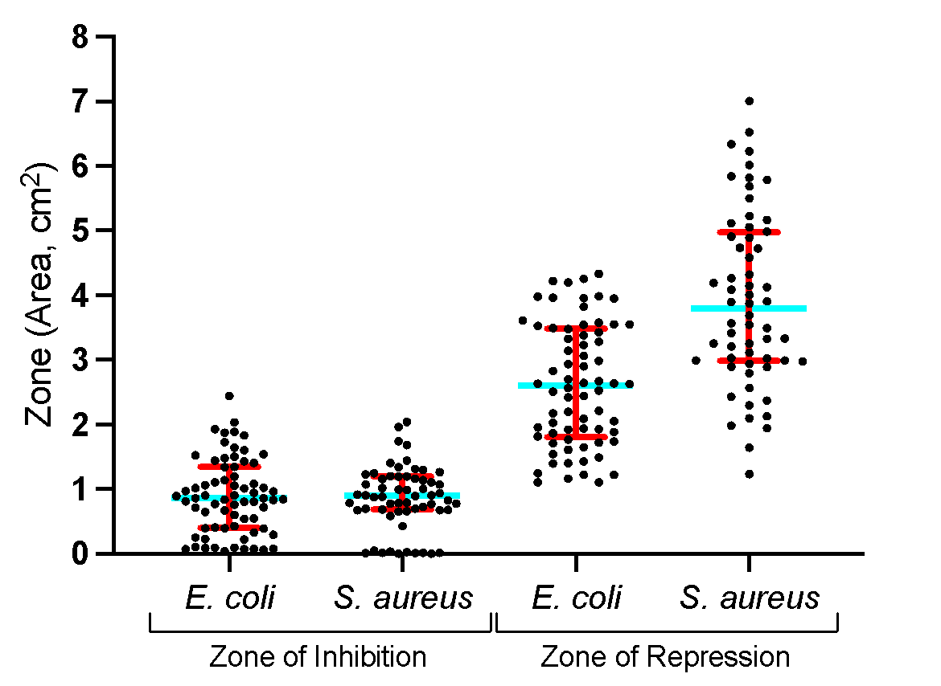
Unbiased Semiquantitative Analysis
Red bars: Interquartile range
Blue bar: median
++++
Key
++++ 75-100% (top quartile)
+++ 50-75%
++ 25-50%
+ 0-25% (bottom quartile)
- When mean value was zero
+++
++
+
Notes:
Each group in the graph represents the four conditions you studied. Note, these results are irrespective of which SCWD the data point is associated with. Blue bar is the median or where 50% of data is above and 50% is below. The red bar represents the interquartile range (50% of data is within this range and 50% is outside). What all of this does is define the quartiles (four of them, 25% of the data is represented in each quartile) and each quartile has been assigned a number of plus signs. I show an example for the S. aureus/repression (see gray box). If the mean value for an SCWD fell within the top quartile then I gave it four pluses, if it fell in the bottom quartile, I gave it one plus. I used the mean value obtained for each SCWD within each condition to determine the assignment of the plus signs.

Slide 14
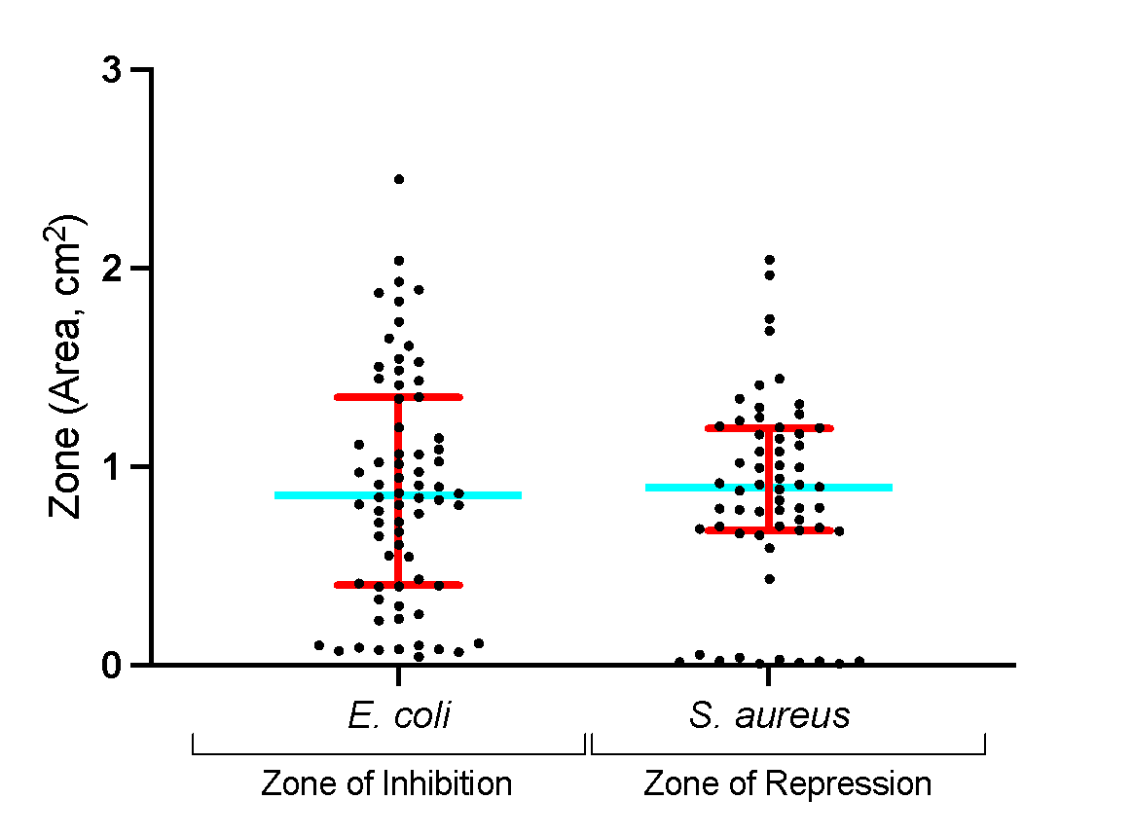
Unbiased Semiquantitative Analysis
Red bars: Interquartile range
Blue bar: median
++++
Key
++++ 75-100% (top quartile)
+++ 50-75%
++ 25-50%
+ 0-25% (bottom quartile)
- When mean value was zero
+++
++
+
Notes:
Each group in the graph represents the four conditions you studied. Note, these results are irrespective of which SCWD the data point is associated with. Blue bar is the median or where 50% of data is above and 50% is below. The red bar represents the interquartile range (50% of data is within this range and 50% is outside). What all of this does is define the quartiles (four of them, 25% of the data is represented in each quartile) and each quartile has been assigned a number of plus signs. I show an example for the S. aureus/repression (see gray box). If the mean value for an SCWD fell within the top quartile then I gave it four pluses, if it fell in the bottom quartile, I gave it one plus. I used the mean value obtained for each SCWD within each condition to determine the assignment of the plus signs.

Slide 15
Composition of SCWDs
Product | Composition
Acticoat Flex 3 | Silver-coated polyethylene Contains .69 mg/cm² - 1.64 mg/cm² Silver nanocrystalline structure (Ag⁰, slow release, converts to Ag⁺)
Aquacel Ag | Silver-coated Hydrofiber sodium carboxymethylcellulose and 1.2% Ag⁺
Maxorb II Ag | Highly Absorbent Silver-coated foam pad Contains a maximum of 0.306 mg of ionic silver per square cm. Contains silver sodium hydrogen zirconium phosphate (Ag⁺)
Mepilex Ag | Silver-coated foam with silicone interface
Mepitel Ag | Silver-coated silicone Contains 0.13 % by weight of Silver Chloride (Ag⁺)
Optifoam Ag | Non-staining Antimicrobial Silver-coated pad
Tegaderm Alginate Ag | Silver-coated fiber Contains silver sodium hydrogen zirconium phosphate (Ag⁺)

Slide 16
Silver-Containing Wound Dressing(SCWD)
Discussion:
Silver is detrimental to bacteria in part through its ability to damage the bacterial cell wall (resulting in increased membrane permeability), block enzyme and transport systems, prevent DNA and RNA replication, and block cellular respiration.^{30,34}
Acticoat Flex-3 and Maxorb II Ag were the most effective bactericidal SCWD against E. coli. In addition, Aquacel Ag, Mepitel Ag, and Tegaderm Alginate Ag were moderately effective, compared with Acticoat Flex-3 and Maxorb II Ag, while Mepilex Ag and Optifoam Ag were the least effective, with the former having virtually no effect.
While there were differences between SCWDs on their effectiveness against E. coli or S. aureus, their relative effect between the two bacterial strains were highly consistent. For example, Acticoat Flex 3 and Maxorb II Ag were highly effective and Mepilex Ag and Optifoam were the least effective against both bacterial strains.

